Slide 1
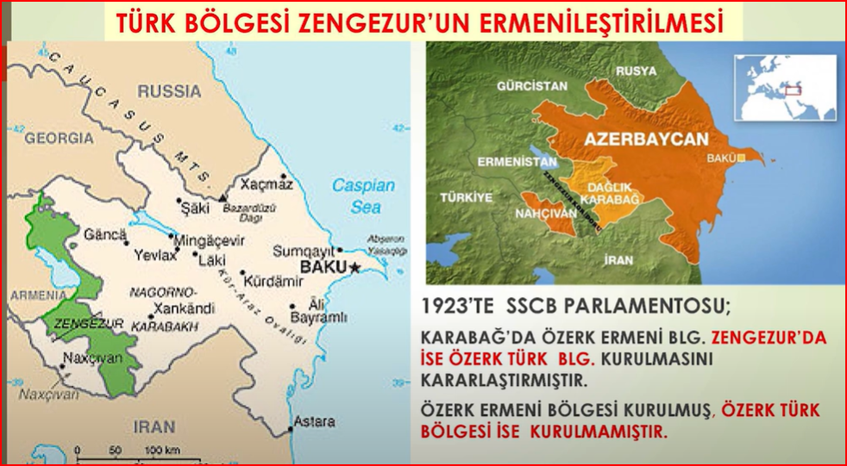
Armenianization of the Turkish region Zengezur
Parliament of the USSR decided in 1923 to establish an autonomous Armenian region in Karabakh and an autonomous Turkish region in Zengezur. The autonomous Armenian region was established, but the autonomous Turkish region was not established.

